Slide 1
L7 Multicore Processors
Zonghua Gu, 2018

Slide 2
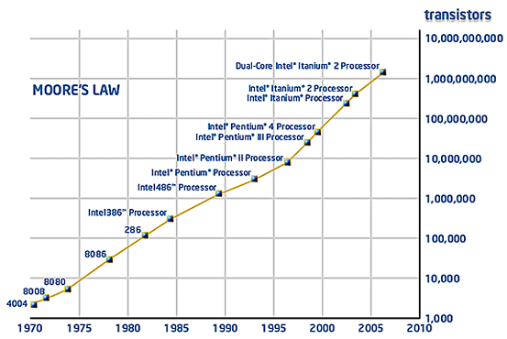
Moore’s law
Number of transistors on the chip doubles every 18 to 24 months
Notes:
the number of transistors that can be inexpensively placed on an integrated circuit is increasing exponentially, doubling approximately every two years
Patterson & Hennessy: number of cores will double every 18 months, while power, clock frequency and costs will remain constant

Slide 3
CPU clock frequency
CPU clock frequency stopped increasing beyond 4 GHz
Power consumption and heat dissipation
Design and verification complexity
Memory wall: bottleneck is memory hierarchy speed, not CPU speed
Power (W)
Pentium Tejas
cancelled!
Nuclear
Reactor
P4
STOP
P3
Pentium
P1
P2
Hot-plate
286
486
8086
386
8085
8080
8008
4004
Year

Slide 4
Keeping Moore’s law alive
If clock frequency can not be increased anymore, how to use the increasing # transistors on the chip?
Multicore processors!
Instead of a single, fast, complex core, switch to multiple, slower, simpler cores
Each core is slower; performance comes from multiple cores working in parallel
Notes:
Use a higher number of slower logic gates
In other words:

Slide 5
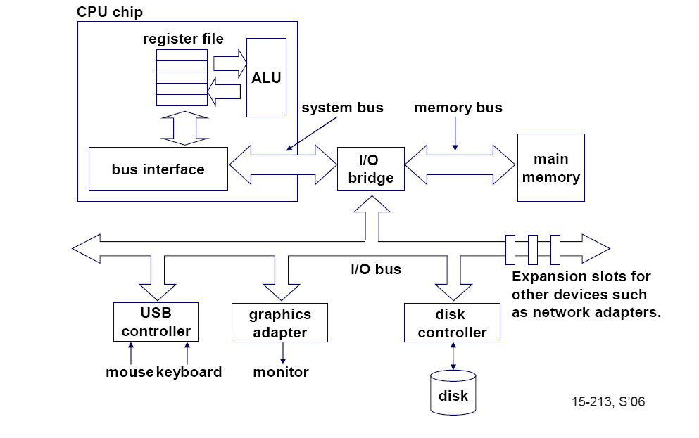
Single-core computer

Slide 6
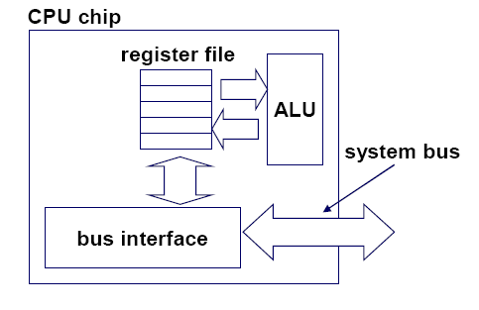
Single-core processor
the single core

Slide 7
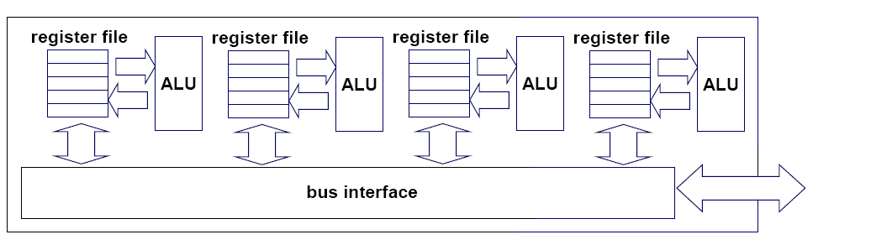
Multicore processor
Core 1
Core 2
Core 3
Core 4
Notes:
This lecture is about a new trend in computer architecture: Replicate multiple processor cores on a single die.

Slide 8
Instruction-level parallelism (ILP)
Parallelism at the machine-instruction level
Multiple instructions are executed in parallel within a single core
The processor core can re-order, pipeline instructions, split them into microinstructions, do aggressive branch prediction, etc.
ILP enabled rapid increases in single-core clock frequencies until ~2005

Slide 9
Thread-level parallelism (TLP)
Parallelism at the thread-level
Multiple threads are executed in parallel, e.g.:
A server can serve each client in a separate thread (web server, database server…)
A computer game can do AI, graphics, and physics in three separate threads
multicore processors can exploit TLP by running multiple threads on multiple cores to achieve maximum performance benefit
Single core processors can exploit TLP by time-multiplexing multiple threads on the same core with OS scheduler, with limited performance benefit
Notes:
Single-core superscalar processors cannot fully exploit TLP

Slide 10
SISD, MIMD and SIMD
SISD (Single-Instruction, Single-Data)
A single core executes a single instruction stream
MIMD (Multiple-Instruction, Multiple-Data)
Each core executes its own instruction stream, each operating on different parts of memory
SIMD (Single-Instruction, multiple-Data)
All cores execute the same instruction stream, operating on different parts of memory
Good for multimedia apps, e.g., an image can be divided into 4 smaller image patches and processed in parallel

Slide 11
SISD, MIMD and SIMD
Instru.
Instru.
Instru.
Instru.
Instru.
Core
Core
Core
Core
Core
Data
Data
Single-core CPU: SISD
Multicore CPU: MIMD
Instruction
Core
Core
Core
Core
Data
GPU: SIMD

Slide 12
MIMD with 4 cores
thread 1
thread 2
thread 3
thread 4
core
1
core
2
core
3
core
4

Slide 13
Within each core, threads are time-slice scheduled by OS
several threads
several threads
several threads
several threads
core
1
core
2
core
3
core
4

Slide 14
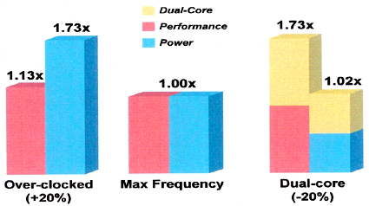
Multicore achieves high perf. With low power
Single-core processor w/ 20% over-clocked CPU frequency
Single-core processor w/ normal CPU frequency
Dual-core processor
w/ -20% underclocked CPU frequency
Notes:
Two or more processor cores on the same chip 1. 2. Single-core processor 3. Two standard processors each under-clocked 20%
Intel Core Duo processor
Semiconductor trends
More transistors available per die
Clock scaling reaching limits due to power constraints. An empirical study suggests that a 1% clock increase results in a 3% power increase.
Moore’s Law has hit a wall due to power constraints

Slide 15
The Multicore invasion
Almost all modern processors are multicore
Raspberry Pi 3: 4 ARM Cortex-A53 cores
Intel Itanium, Xeon...
AMD Opteron, Athlon...
IBM-Toshiba-Sony Cell processor for Sony playstations: 8 cores
Oracle Niagara UltraSPARC
Tilera TILE64: 64-core
TI, Freescale, Atmel, Broadcom..
Small low-power embedded processors may still be single-core
Arduino: single ARM core
Notes:
Network Processors andare being replaced by s (Broadcom) Nios II: x soft Cores
DSP
Picochip: communication domain

Slide 16
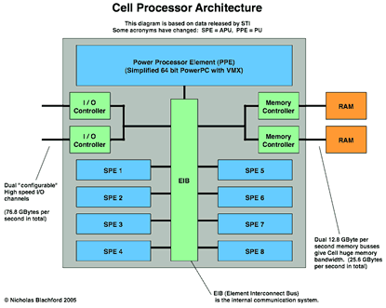
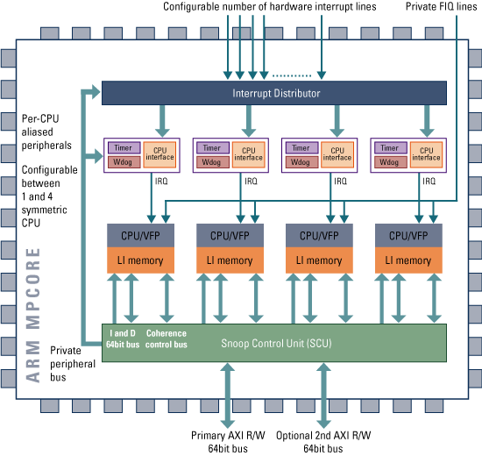
Homogenous vs heterogenous cores
ARM MPCore
IBM Cell Processor
Homogeneous multicore w/
4 identical ARMv6 cores
One Power Processor Element (PPE)
8 Synergistic Processing Element (SPE)

Slide 17
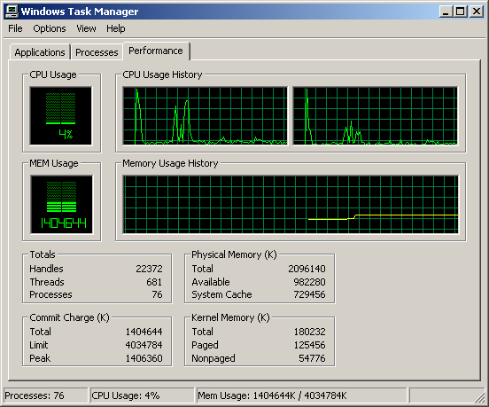
Windows Task Manager
core 2
core 1

Slide 18
Memory hierarchy on multicore
L1 caches private to each core
L2/L3 caches private in some architectures; or shared among cores in others
We assume main memory is always shared by all cores
In large high-performance processors, each core may have its own private memory; not considered in this lecture

Slide 19
Intel Xeon processors
hyper-threads
Dual-core Intel Xeon processors
L1 caches are private
L2 cache is shared
C O R E 1
C O R E 0
L1 cache
L1 cache
L2 cache
memory

Slide 20
Designs with private L2 caches
C O R E 1
C O R E 0
C O R E 1
C O R E 0
L1 cache
L1 cache
L1 cache
L1 cache
L2 cache
L2 cache
L2 cache
L2 cache
L3 cache
L3 cache
memory
memory
Both L1 and L2 are private
Examples: AMD Opteron, AMD Athlon, Intel Pentium D
L1/L2/L3 are all private Example: Intel Itanium 2

Slide 21
Private vs shared caches?
Advantages/disadvantages?
Advantages of private:
Faster access: closer to core, and no need for cache coherence protocol
Better performance isolation: no contention between different private caches
Advantages of shared:
Higher utilization: better sharing of the shared cache among multiple cores

Slide 22
The cache coherence problem
Since we have private caches: How to keep the data consistent across caches?
Each core should perceive the memory as a monolithic array, shared by all the cores
Core 1
Core 2
Core 3
Core 4
One or more levels of cache
One or more levels of cache
One or more levels of cache
One or more levels of cache
Main memory
inter-core bus

Slide 23
The cache coherence problem
Suppose variable x initially contains 15213
Core 1
Core 2
Core 3
Core 4
Private cache
Private cache
Private cache
Private cache
Main memory
x=15213

Slide 24
The cache coherence problem
Core 1 reads x
Core 1
Core 2
Core 3
Core 4
Private cache
x=15213
Private cache
Private cache
Private cache
Main memory
x=15213

Slide 25
The cache coherence problem
Core 2 reads x
Core 1
Core 2
Core 3
Core 4
Private cache
x=15213
Private cache
x=15213
Private cache
Private cache
Main memory
x=15213

Slide 26
The cache coherence problem
Core 1 writes to x, setting it to 21660
Core 1
Core 2
Core 3
Core 4
Private cache
x=21660
Private cache
x=15213
Private cache
Private cache
Main memory
x=21660
assuming write-through caches

Slide 27
The cache coherence problem
Core 2 attempts to read x… gets a stale copy
Core 1
Core 2
Core 3
Core 4
Private cache
x=21660
Private cache
x=15213
Private cache
Private cache
Main memory
x=21660

Slide 28
Cache coherence protocols
A simple protocol: invalidation with snooping
Invalidation: If a core writes to a data item, all other copies of this data item in other caches are invalidated
Snooping: All cores continuously “snoop” (monitor) the bus connecting the cores.

Slide 29
Invalidation with snooping
Revisited: Cores 1 and 2 have both read x
Core 1
Core 2
Core 3
Core 4
Private cache
x=15213
Private cache
x=15213
Private cache
Private cache
Main memory
x=15213

Slide 30
The cache coherence problem
Core 1 writes to x, setting it to 21660
Core 1
Core 2
Core 3
Core 4
Private cache
x=21660
Private cache
x=15213
Private cache
Private cache
sends invalidation request
INVALIDATED
Main memory
x=21660
assuming write-through caches
inter-core bus

Slide 31
The cache coherence problem
After invalidation:
Core 1
Core 2
Core 3
Core 4
Private cache
x=21660
Private cache
Private cache
Private cache
Main memory
x=21660

Slide 32
The cache coherence problem
Core 2 reads x. Cache misses, and loads the new copy.
Core 1
Core 2
Core 3
Core 4
Private cache
x=21660
Private cache
x=21660
Private cache
Private cache
Main memory
x=21660

Slide 33
Alternative to invalidate protocol: update protocol
Core 1 writes x=21660:
Core 1
Core 2
Core 3
Core 4
Private cache
x=21660
Private cache
x=21660
Private cache
Private cache
UPDATED
broadcasts updated value
Main memory
x=21660
assuming write-through caches
inter-core bus

Slide 34
Invalidation vs update
Multiple writes to the same location
invalidation: only the first time
update: must broadcast each write (which includes new variable value)
Invalidation generally performs better: it generates less bus traffic

Slide 35
Cache Coherence protocols
This is a very basic protocol
More sophisticated protocols add extra bits to each cache block to indicate state
MESI (Modified, Exclusive, Shared, Invalid)

Slide 36
Interaction with the OS
Each thread has an affinity mask, a bit vector that specifies what cores the thread is allowed to run on
Default affinity mask is all 1s: all threads can run on all processors
For threads with default affinity mask, the OS scheduler maps threads to cores for load balancing
Upon detection of skewed workloads, OS scheduler migrates threads to less busy processors to achieve load-balancing
Notes:
Write parallel algorithms
decides what threads run on what core

Slide 37
Soft affinity
Thread migration in multicore can be costly
Need to warm up the private cache of the destination core
Source core’s cached data become invalid
Need to restart the CPU execution pipeline on destination core
Soft affinity: OS scheduler tries to avoid migration, and tends to keeps a thread on the same core unless load is very skewed

Slide 38
Hard affinity
The programmer can set hard affinities in the program
If multiple threads share data, map to same core so they can use L1 private cache to pass data efficiently
A hard real-time thread can be mapped to a dedicated core to ensure performance isolation
Example: a thread running a robot controller should not be context-switched to avoid instability of control system

Slide 39
Affinity mask examples
On a 4-core processor
1 | 1 | 1 | 1
1 | 1 | 0 | 1
core 3
core 2
core 1
core 0
core 3
core 2
core 1
core 0
Default affinity mask: This thread is allowed to run any core, managed by OS scheduler
Programmer-specified affinity mask: this thread is not allowed to run on core 1; OS scheduler manages its mapping to cores 0,2,3
0 | 0 | 1 | 0
core 3
core 2
core 1
core 0
Programmer-specified affinity mask: This thread is only allowed to run on core 1

Slide 40
Kernel scheduler API
#include <sched.h>
int sched_getaffinity(pid_t pid, unsigned int len, unsigned long * mask);
int sched_setaffinity(pid_t pid, unsigned int len, unsigned long * mask);
These API calls get/set the current affinity mask of process with “pid’ to a bit mask

Slide 41
Summary
Multicore motivation
SISD, MIMD and SIMD
Cache coherence protocol
Affinity masks

